Slide 1
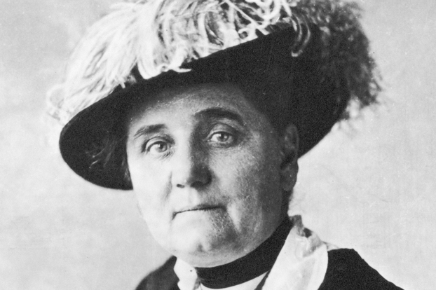
Girls in the Juvenile Justice System
Sarah Cusworth Walker, PhD
WAPA 2018

Slide 2
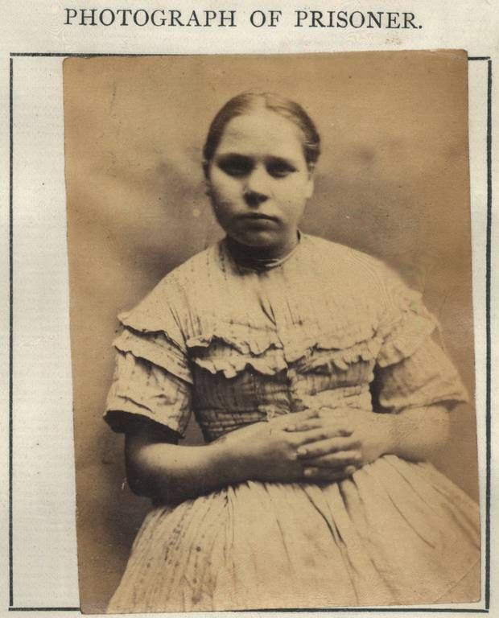
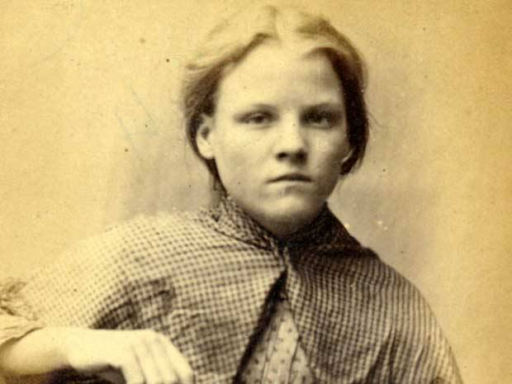
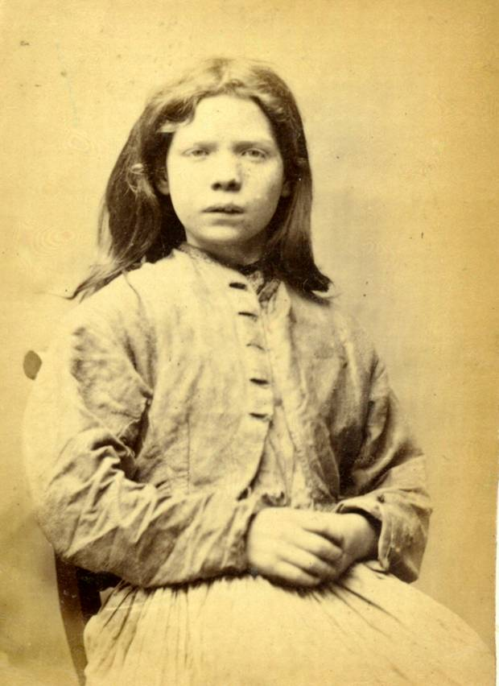
Prior to late 1800’s, juveniles were tried and sentenced as adults
Rosanna Watson
13 years old
Seven days hard labor in adult prison
Stealing iron
Margaret Cosh
15 years old
Two months hard labor in adult prison
Stealing a coat
Mary Catharine Docherty
14 years old
Seven days hard labor in adult prison
Stealing iron
Tyne & Wear Archives & Museum

Slide 3
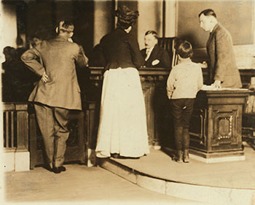
Juvenile courts were established because of the recognition that children were fundamentally different than adults
Cook County, Illinois 1899 first juvenile court (image above from St. Louis, MO). Children’s Bureau archives

Slide 4
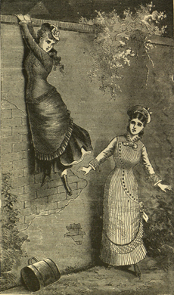
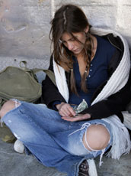
Girls’ pathways into the system have stayed largely consistent over time
1932
  Girls more often in contact with juvenile courts for “running away,” “ungovernable or beyond parental control,” and “sex offense.”
  Boys charged with “ungovernable” more likely to be younger than 12, whereas girls charged with “ungovernable” more likely to be older than 12.
  Modern Day
  57% of girls have family/guardian conflicts that facilitate contact with the system: (13%), movement toward detention and incarceration (34%) or both (10%).
  Girls more likely to run away and more likely to be arrested when they run

Slide 5
(Age 17) “She didn’t like me going out partying . . .and she tried – convincing me not to go-. . .she would say, “Please be home by two.” And I would never be home by two . . .it’s not like you’re gonna be home by two, you know, it’s like – two? I leave at twelve, how am I gonna be back by two- you know?” Quoted in Davis, 2007
Notes:
Breakdown in family roles, with mother taking a pleading role. Girl refuses the legitimacy of her mother’s authority.

Slide 6
“The recognition that some parents turn to the courts to enforce their authority is thought to be a primary reason for many girls’ presence in the juvenile justice system.” Davis, 2007

Slide 7
Changes in detention policies have likely contributed to a rise in assault charges for girls
1980 Juvenile Justice and Delinquency Prevention Act Reauthorization
  Not allowed to confine status offenders (e.g., runaways, underage drinking) if they violated court orders
By 1988, number of status offenders in secure facilities declined by 95% (U.S. General Accounting Office, 1991)

Slide 8
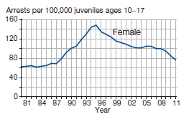
Girls are represented in the justice system at higher rates now than ever in previous history
Between 1980 and 1994, the rate of violence crimes for females doubled. Overall rates since 1980’s: 20 to 30% of all juvenile arrests. Male crime has decreased much more quickly.

Slide 9
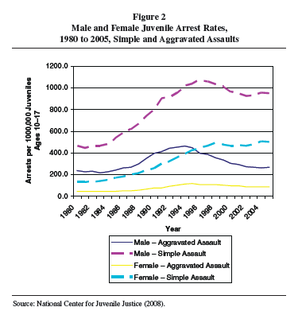
Increase in girl involvement largely due to increases in charges for simple assault

Slide 10
The number of girls in the justice system has sparked a national discussion about whether the “traditional” model of juvenile corrections is appropriate for females
What are the characteristics of justice-involved girls?
Are pathway models of delinquency (the basis for policy and intervention) predicting girls’ delinquency as well as boys’?
What treatments are effective for girls in reducing delinquent behavior/justice contact?

Slide 11
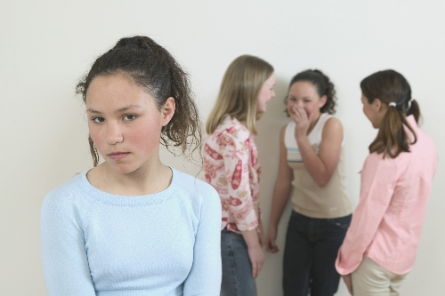
characteristics
Girls Involved in the Juvenile Justice System

Slide 12
Justice-involved girls have higher rates of mental health disorder than boys
Non-detained Delinquent Nondelinquent
 | Boys | Girls | Boys | Girls
PTSD | 9% | 23% | 3% | 7%
MDD | 12% | 45% | 10% | 14%
Alcohol Abuse | 25% | 26% | 3% | 5%
Drug Use | 34% | 34% | 5% | 6%
Sexual Assault | 9% | 26% | 3% | 10%
Physical Assault | 47% | 40% | 14% | 10%
Physical Abuse | 31% | 35% | 9% | 11%
Adams, McCart, Zajac, Danielson, Sawyer, Saunders & Kilpatrick (2013)

Slide 13
Exposure to violence and trauma is even higher among girls who are detained
  70% exposed to some type of trauma
  65% had some symptoms of PTSD
  49% experiencing current PTSD symptoms
National Child Traumatic Stress Network, 2004; Cauffman et al, 1998; Teplin 2005

Slide 14
Justice-involved girls experience additional social stressors
Justice-involved girls reported multiple difficulties associated with being female, a collective sense of worthlessness that they hoped to improve by seeking approval through relationships with males.
More sensitive to perceived threats and others’ expectations.
Girls who display impulsivity and low empathy (more typically male traits) at higher risk of social isolation.

Slide 15
“[The violent girl] is at once more socially conscious and more brutalized than the violent boy and the least connected to her family.” Artz, 2005
Notes:
Girls who are violent report more fear of sexual and physical abuse, but also rate relationships as impt and violence as undesirable but “necessary.”

Slide 16
Trends in Washington State mirror national statistics
Walker, 2010

Slide 17
Predictors of delinquency
Girls Involved in the Justice System

Slide 18
Many risks for offending are shared between genders while some risks are unique
ADHD
Low cortisol levels
Low resting heart rate
Early pubertal maturation
Neuropsychological impairments
Co-morbid mental health problems
Lower levels of empathy
Heightened sensitivity to rewards/ stimulation
Dysfunctional families/antisocial socialization
Harmful pre/post-natal biological experiences
Poor parental monitoring
Early interpersonal victimization
Negative temperament
Deviant peers
Poverty
Impulsivity
Low IQ
MALES
FEMALES
Adversarial
interpersonal
Relationships
EEG brain
Asymmetries
R > L frontal
activation
Lower levels
of MAOA
Genotype
Fight or flight
Asha Goldweber, Lisa Broidy, and Elizabeth Cauffman, “Interdisciplinary Perspectives on Persistent Female Offending: A
Review of Theory and Research,” in The Development of Persistent Criminality, edited by J. Savage (Cambridge University Press,
forthcoming).

Slide 19
In other direct comparisons, interactions with gender all indicate stronger predictive valence for males

Slide 20
Pathway models of delinquency are somewhat accurate in explaining female delinquency but not as good as for males, particularly for serious delinquency
Overt
Covert
Authority Conflict

Slide 21
Latent class analysis study
Girls Involved in the Juvenile Justice System

Slide 22
Sample Demographic Description
Variable |  | n = 1731
Gender | Female | 1731 (100%)
Race/Ethnicity | Caucasian | 1157 (66.8%)
 | African American | 213 (12.3%)
 | Hispanic/Latino | 221 (12.8%)
 | Asian | 41 (2.4%)
 | Native American | 91 (5.3%)
 | Other | 8 (0.5%)
Age (in years) | 10 – 23 | m = 14.82, median = 15, range = 10-23, sd = 1.45

Slide 23
High Trauma, Family Disruption, and Substances
High in violent behavior
Least likely to be living with 2 parents
High foster care
History of running away
No positive adult relationships
School performance
Family conflict
Negative peer ties
Parenting discipline
Parenting problems
History of neglect
History of sexual abuse
History of physical abuse
History of mental health treatment
Out of home placements
Drug use causes disruption
Alcohol use causes disruption
Low Risk High Protective Factors with Some Mental Health
Highest income, relatively
Some foster care
Low Trauma and Mental Health Need, Poor Parenting
Fewest in foster care
Most likely to be with 2 parents
Strong negative Peer Ties, Moderate to High Risk in all domains
About half gang involved
Next highest level of violence
Variables in Latent Classes
Classes
Covariates

Slide 24
Treatment considerations
Girls Involved in the Juvenile Justice System

Slide 25
Paradigms for Treatment
Feminist
Behavior is a reasonable response to impossible situations – not cognitive distortions
What Works
Systematic, manualized
Empowerment, self/body image, media literacy, social justice
Rigorous testing
Thoughts, behaviors, emotions, skills-based
Walker, Muno, Sullivan-Colglazier, 2012; Covington, 2003; Chesney-Lind, 2008; Hubbard & Matthews, 2008

Slide 26
The most well-established, evidence-based treatments for delinquency have promising or mixed effects for girls (or have not done adequate subgroup analysis)
Preliminary evidence for positive effects.
Functional Family Therapy
Effects for girls in treatment better than girls in comparison but lower than boys in treatment
Multidimensional treatment foster care
Initial trial found that problem behaviors for girls increased
May not be as successful in reducing out of home placement
Subsequent program adaptations improved outcomes
MultiSystemic Therapy

Slide 27
We know even less about programs developed specifically for justice-involved girls

Slide 28
Multiple county evaluation of “girls’ groups” found no relationship with recidivism despite high acceptability with girls
Frequency of recidivism
  - Girls Group, beta = 0.10, p = .05 (ns)
Seriousness of Offending
  Girls Group, beta = .03, ns
Differences in type of treatment
  Girls Circle vs Girl Power!, beta = 0.02, ns

Slide 29
What girls have to say: They rank cognitions and relationship problems high as causes for distress
Causal beliefs about depression (n = 67)
Cause | Frequency
Cognitions (negative thoughts) | 94%
Personality | 94%
Relationship issues | 85%
Family issues | 81%
Trauma | 76%
Friends | 69%
Physical causes | 43%
Caporino, 2012

Slide 30
Girls Only! Active Learning
GOAL
Girls Involved in the Juvenile Justice System

Slide 31

Group-based
10.5 weeks, 2x weekly
Development team
  Snohomish, King & Pierce
Implementation partners
  Above plus Lewis, Thurston and Jefferson

Slide 32
Target Population
Girls 13-17 years old
Selective Prevention: Justice involved as well as community-identified as at risk
Eligibility
  Hx of running/out of home placement; Poor family support; no or antisocial friends; exposure to witnessed or direct violence: CLASS ONE GIRLS
Exclusion criteria
  Thought disorder
  Proud of antisocial behavior
  More than one felony adjudication

Slide 33
Program Components
Program Modalities
Identify emotions and triggers
Emotion Regulation
Learn self-calming strategies
Identify inaccurate/ harmful thoughts
Cognitive Restructuring
Practice positive self talk
Encourage reasoning before action
Prosocial Skills & Problem-solving
Discussion of moral scenarios
Psychoed on parenting adolescents
Parent Engagement
Connection to parent support resources
All Program Modalities use 1) Expert Modeling; 2) Role Play; 3) Transfer Training; 4) Emphasis on relationship; 5) Sensitivity to traumatic experiences

Slide 34
Policy context
Girls Involved in the Juvenile Justice System

Slide 35
Advocacy and Policy
Justice for Girls Coalition of Washington State
  Biannual conference “Beyond Pink”
  Handbook
  Technical Assistance
HB 6255 (passed 2012)
  Prostitution sentences vacated
HB 1524 (passed 2013)
  Expands diversion options for youth with mental health challenges
HB 2722 (likely to die in Rules this session)
  Increases discretion for arrest of youth for child-parent DV

Slide 36
Acknowledgments
Thanks to:
Asia Bishop, Research Analyst
National Survey: Ann Muno, Cheryl Sullivan-Colglazier, Justice for Girls Coalition of Washington State, Ryan Pinto,
Latent Class Analysis: Paula Nurius, Patricia Logan-Greene
Girls Circle Evaluation: King, Benton-Franklin and Pierce County Juvenile Courts
GOAL Development team: Chris Hayes, Susan Waild, Sarah Veele, Rosemary Fraine, Mike Irons, Jennifer Crossen, Jaime Reed, Angie Thompson, Karen Gough, Barbara Carr, Lucy Berliner, Leslie Leve
And, in general: Eric Trupin and the PBHJP faculty and staff

